Slide 1
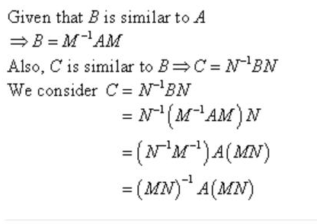
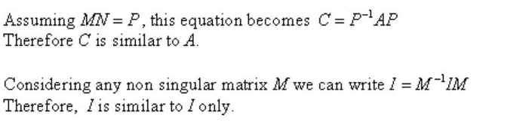
Exercise 5.6 A is similar to B if there is invertible matrix P such that A=P⁻¹BP

Slide 2
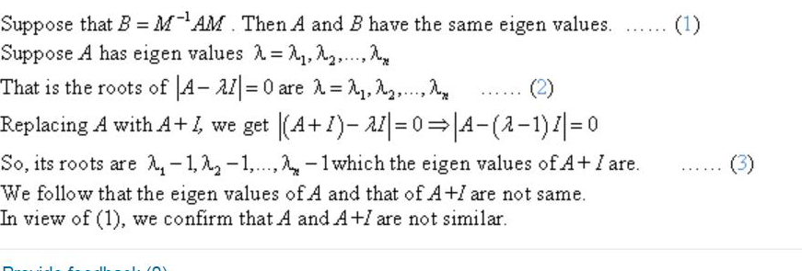
Solution 3

Slide 3
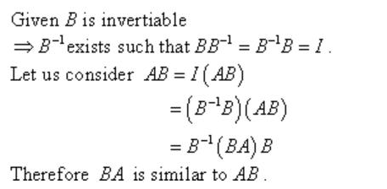
Solution 5 A⁻¹A=AA⁻¹=I BA=A⁻¹ABA=A⁻¹(AB)A (A⁻¹)⁻¹(BA)A⁻¹=AB

Slide 4
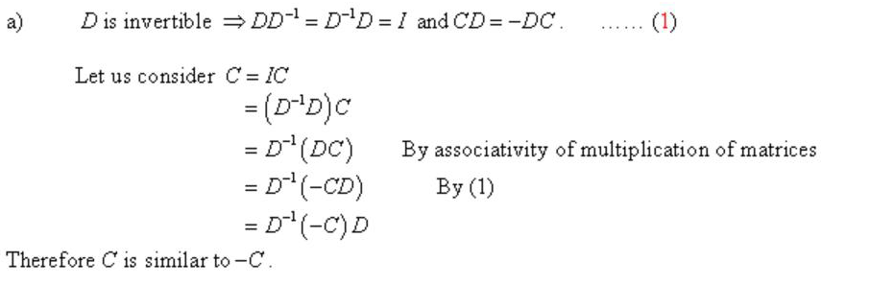
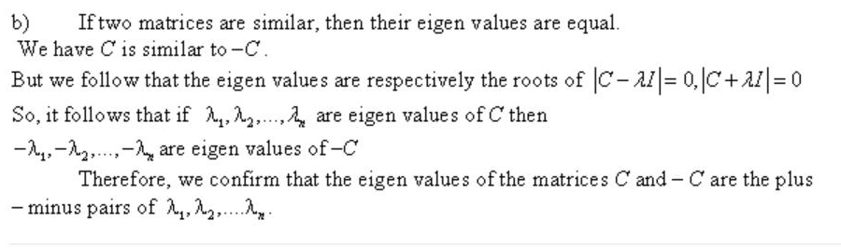
Solution 6

Slide 5
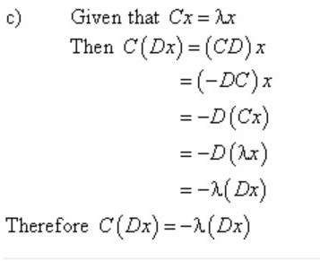
Ax=λx A⁻¹Ax=A⁻¹ λx implies that 1/ λ x=A⁻¹x A²x=AAx=A λx= λAx= λλx= λ²x A²x = λ²x

Slide 6
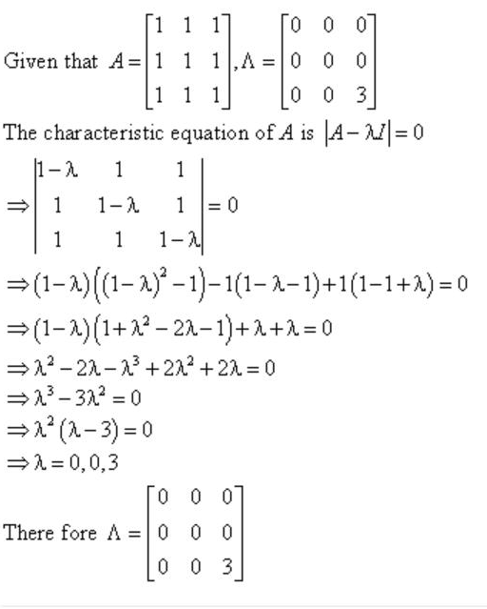
Solution P 16

Slide 7
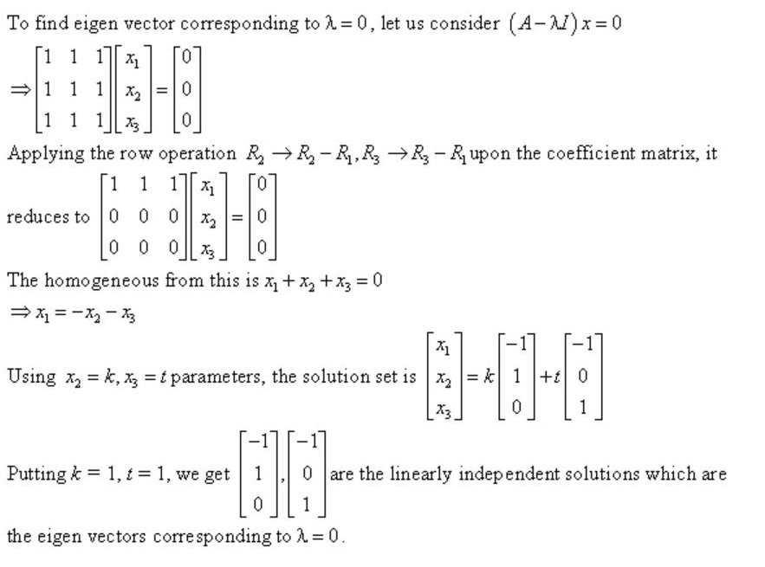

Slide 8
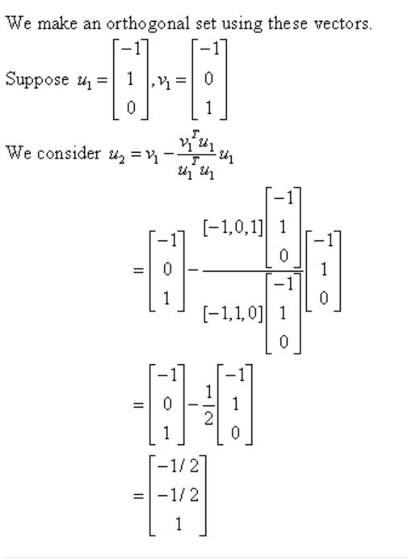

Slide 9
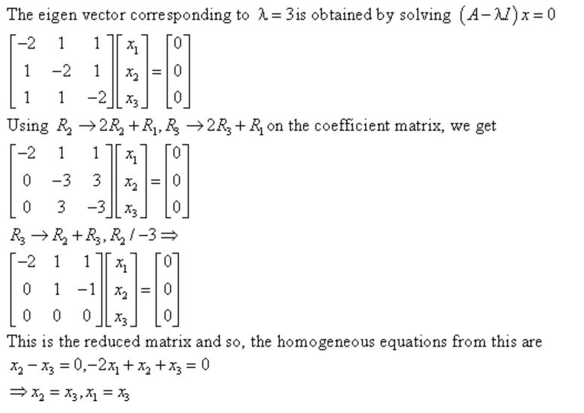

Slide 10
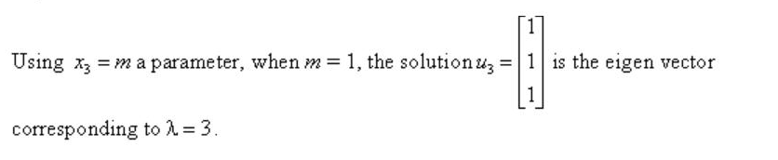
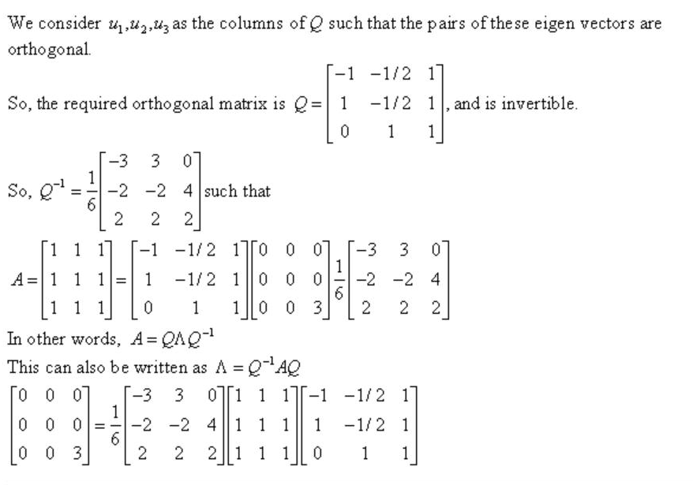

Slide 11
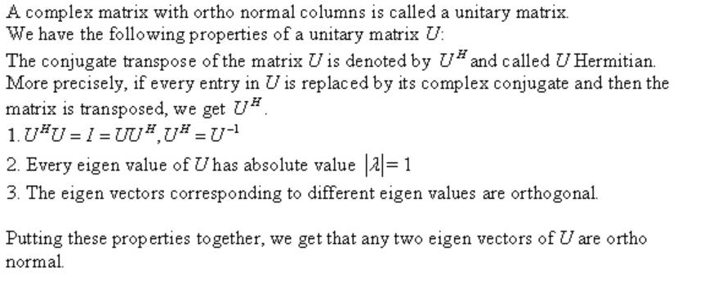
Solution 17

Slide 12
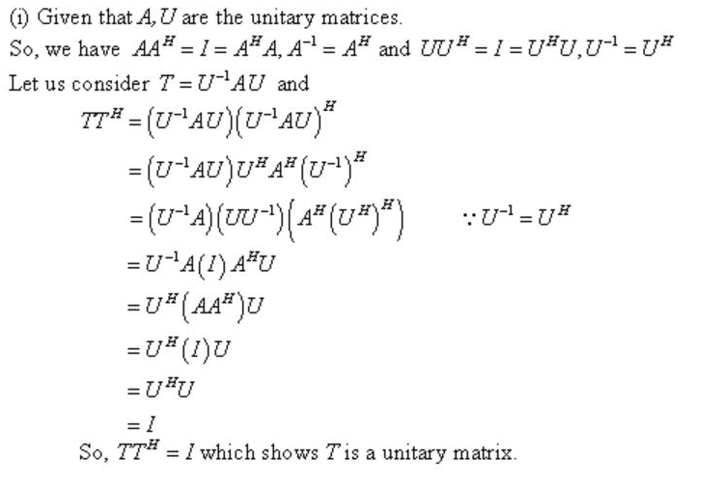

Slide 13
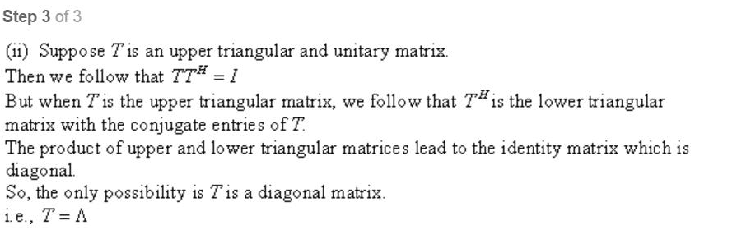

Slide 14
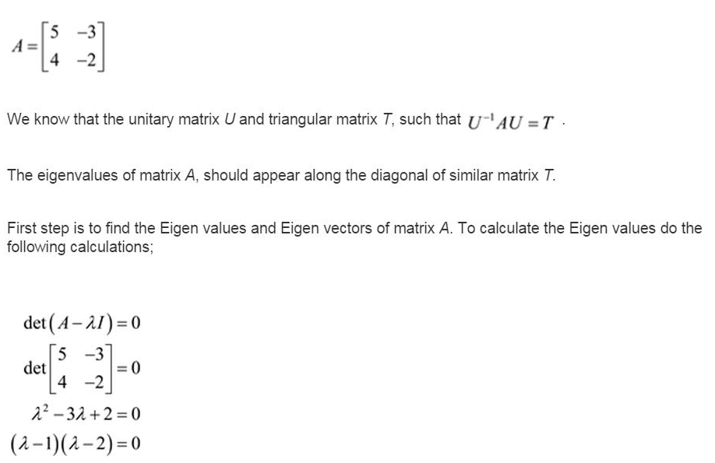

Solution 22

Slide 15
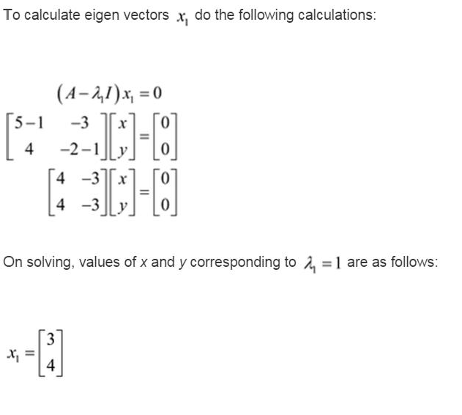

Slide 16
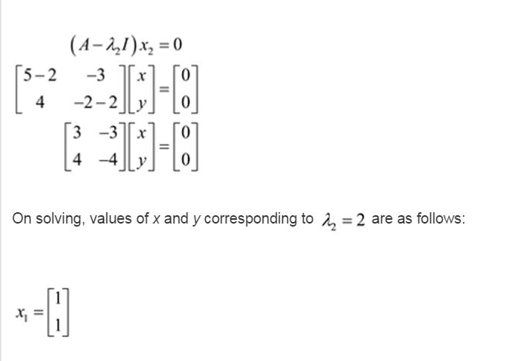

Slide 17
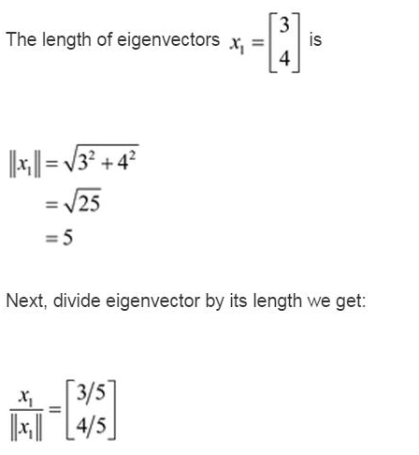

Slide 18
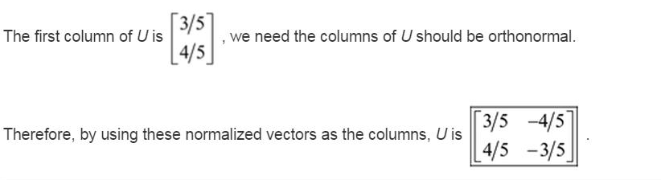

Slide 19
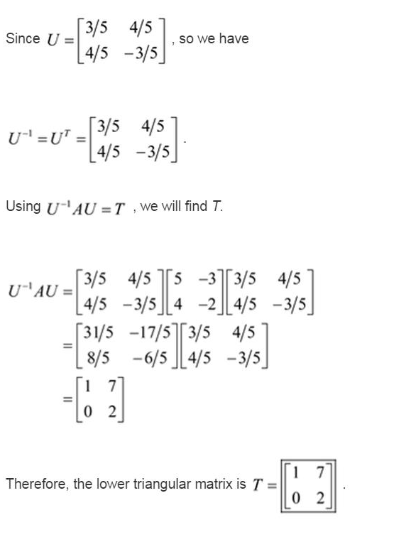

Slide 20
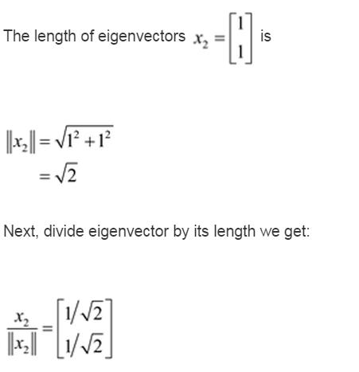
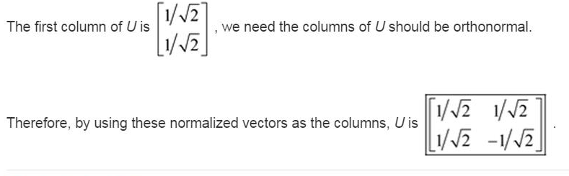

Slide 21
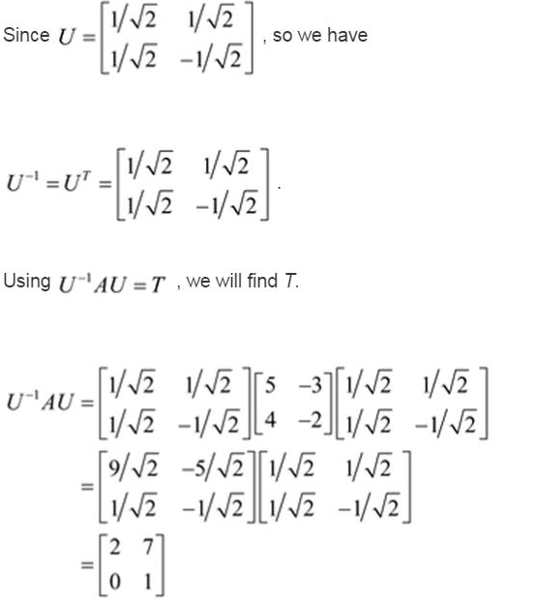

Slide 22
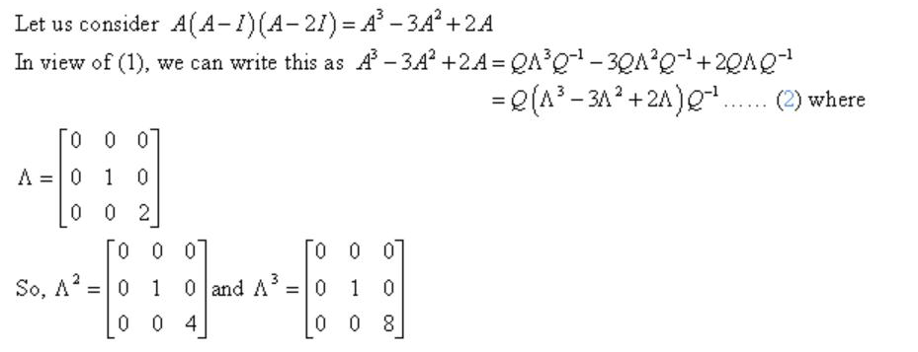
Solution 23

Slide 23
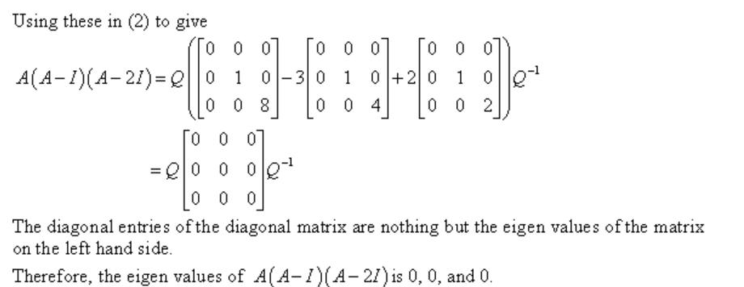

Slide 24
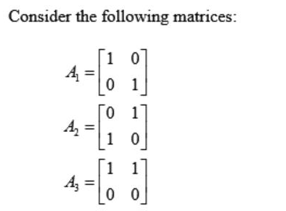
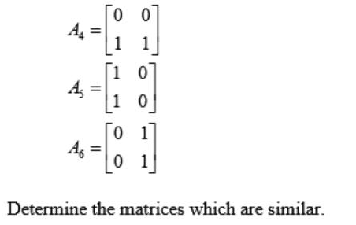
Solution 31
Remember that two matrices are said to be similar if they have same eigen values. If two different matrices have same eigen values then that matrices are termed as similar matrix.

Slide 25
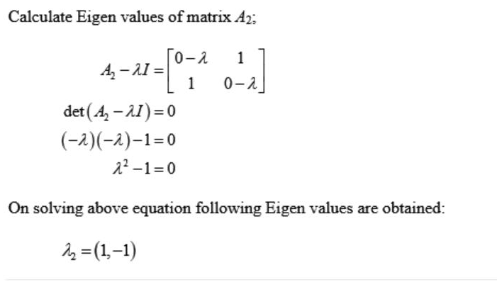
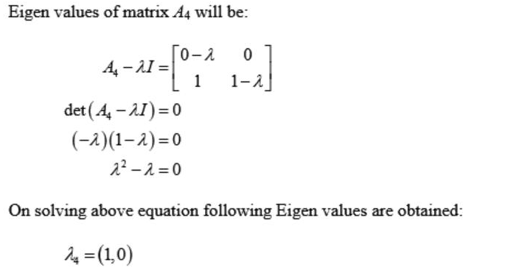

Slide 26
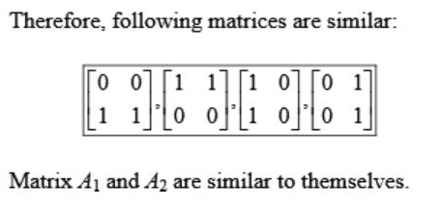
Because these matrices have same eigen values. You can check by computing the eigen values of these matrices by yourself.

Slide 27

x₁=-x₂-x₃ _{x2=k, x3=t}

